Slide 1
Project 4: Algorithm Implementation and Evaluation
Group 6: Rishav Agarwal (ra3141), Jingwei Liao (jl5983),
Ke Liu (kl3344), Jiuru Wang (jw4150), Xinran Wang (xw2809)

Slide 2
01
Introduction to Dataset

Slide 3
Dataset: Bank (Used for A3 Evaluation by the paper)
Number of variables: 16 Number of observations: 45211
· One-hot encode: job, martial, contact, education, output
· Numeric: age, day, month
· Binary: default, housing, loan
Sensitive Attribute: age (also removed from feature to avoid disparate treatment)
Criteria: 25-60 protected group, otherwise non-protected group
Using Logistic Regression to predict whether a person subscribed to term deposit in investment.

Slide 4
Dataset: COMPAS
compas-scores-two-years.csv
· Features: Age, Charge Degree, Gender, Prior Counts, Length Of Stay
· Predicted Label: Two Year Recid (whether or not the defendant recidivated within two years)
· Sensitive Attribute: Race (Caucasian: 1, African-American: 0)
· Data Splitting: training: validation: testing = 5 : 1 : 1

Slide 5
Data preprocessing
on CAMPAS
· Age: age < 25, 25 < age < 45, age > 45
· Charge Degree: Misdemeanor or Felony
· Gender: Male or Female
· Prior Counts: 0, 1-3, larger than 3
· Length of Stay: <= 1 week, <= 3 months or > 3 months
Reference: How We Analyzed the COMPAS Recidivism Algorithm — ProPublica
https://github.com/propublica/compas-analysis/blob/master/Compas%20Analysis.ipynb

Slide 6
02
Introduction to Algorithms

Slide 7
Algorithms: A3 & A7
Maximizing Fairness under Accuracy Constraints (Gamma and Fine-Gamma)
Fairness-aware Feature Selection

Slide 8
A3: Maximizing Fairness under Accuracy Constraints (Gamma and Fine-Gamma)
General Goal
Design classifiers—convex margin-based classifiers like logistic regression and support vector machines (SVMs)—that avoid both disparate treatment and disparate impact, and can additionally accommodate the “business necessity” clause of disparate impact doctrine.
Two distinct notion
1. Disparate treatment: decision based on subject’s sensitive attribute information
2. Disparate impact: outcome hurts/benefits people with certain sensitive attribute values

Slide 9
Way to quantify disparate impact
“80%-rule” or “p%-rule”
Decision Boundary Covariance

Slide 10
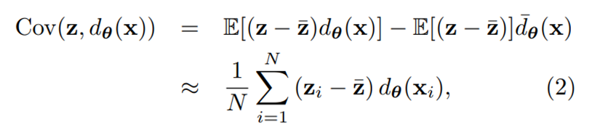
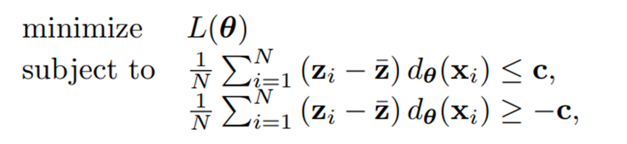
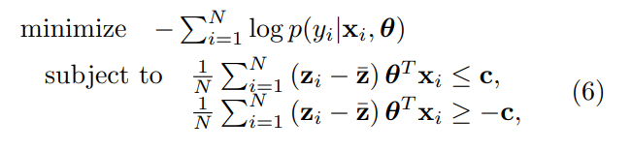
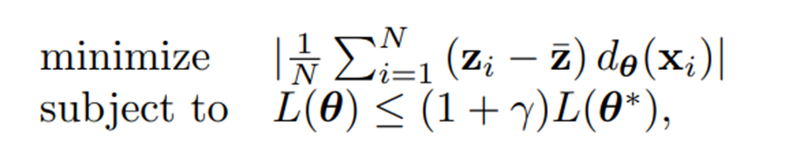
Formulas
Decision Boundary Covariance
Maximizing Accuracy Under Fairness Constraints
Logistic Regression
Maximizing Fairness Under Accuracy Constraints

Slide 11
A7: Fairness-aware feature selection
A framework for feature selection by computing the fairness-utility score for each feature which captures its accuracy and discriminatory impacts.
The score depends only on the joint statistic of the data and not on the particular classifier at hand.
Goal: Select features that optimally satisfy accuracy and fairness requirements.
Problem: Tradeoff between accuracy and fairness. May remove some discriminatory features which contain important information to make pridiction.

Slide 12
How to measure those impacts?
Propose accuracy coefficient and discrimination coefficient based on mutual information
Aggregate these two coefficients by shapley value function
Process
Find all subsets of feature space excluding ith feature
Calculate marginal information contribution of including ith feature for each subset
Calculate weighted average over all subsets
Repeat for each feature

Slide 13
03
Evaluation Results

Slide 14
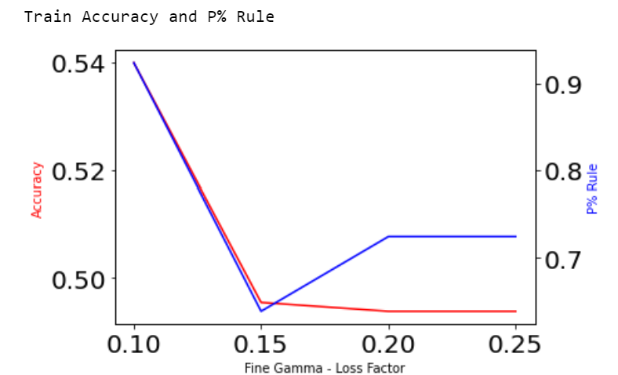
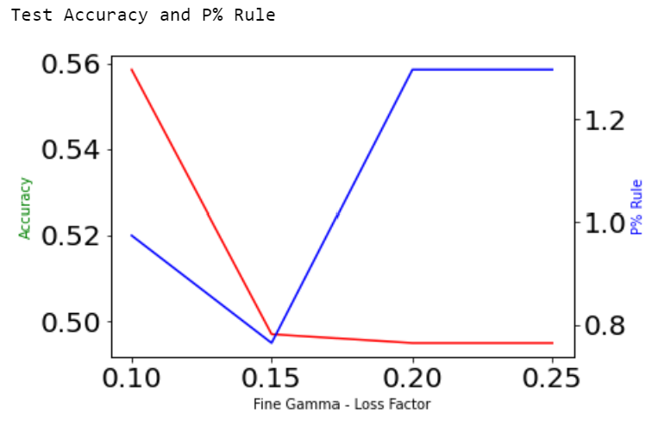
A3: Fairness Constraints: Mechanisms for Fair Classification
We have the Train and Test Accuracy, which shows a decrease when Fine-Tuning Gamma, to give the constrained algorithm. P% also gives us the ratio between protected and unprotected class based on the test data, denoted by 1 and 0.

Slide 15
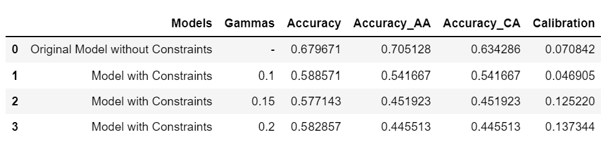
Results
Initially, we used a Logistic Regression without any constraints, which gives us the accuracy of 0.67% where both the races are involved. Subsequently, we started the process of constraining the accuracy in order to ensure fairness of the model. Here, we started seeing a decrease in the accuracy but the calibration showed an accuracy, going close to 0.14, as compare to 0.07 without the constrained model.

Slide 16
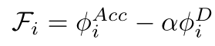
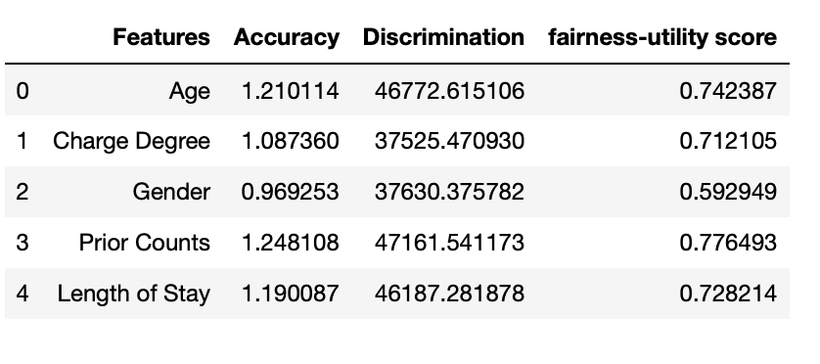
A7: Feature selection & Model Evaluation
Hyperparameter(𝛼) tuning:
Calculate fairness-utility score for each feature under a choice of 𝛼
Include features with high score or exclude features with low score(similar to Best Subsets Algorithm)
Build ML model using features; evaluation metrics: accuracy and calibration
Example: 𝛼 = 0.00001
Remove Gender to get a subset of size 4

Slide 17
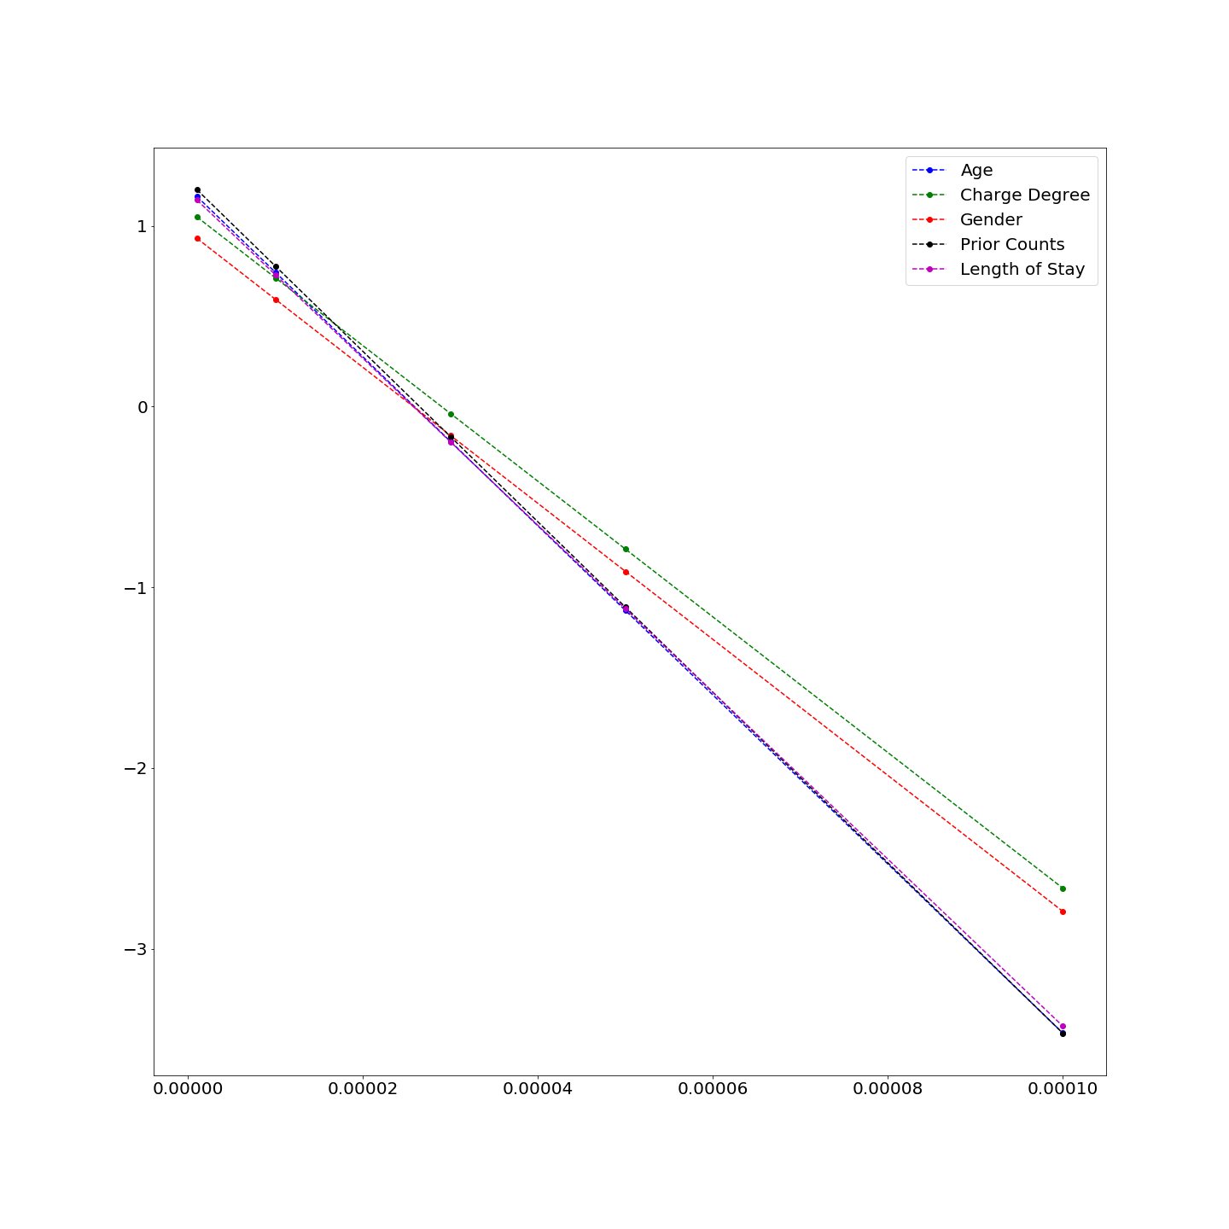
Tuning 𝛼
To get a subset of size 4:
1) When 𝛼=0.000001 and 𝛼=0.00001: remove Gender;
2) When 𝛼=0.00003:
remove Length of Stay;
3) When 𝛼=0.00005:
remove Age;
4) When 𝛼=0.0001:
remove Prior Counts.
To get a subset of size 3:
Remove the feature with the second
Lowest score under each chosen 𝛼
…

Slide 18
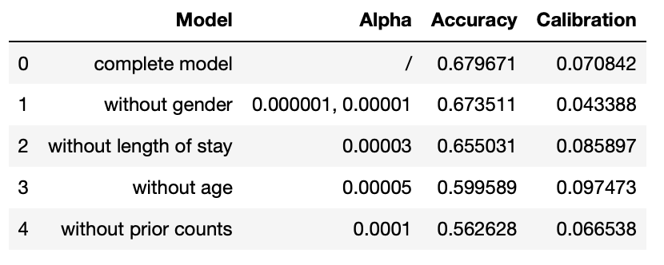
Feature selection results
To maintain a considerable accuracy and complexity of the model, we compared the complete model and models with feature size of 4 under different choice of 𝛼
The model without gender is probably the best model considering the accuracy and discrimination effect at the same time.
As expected, when 𝛼 increases, accuracy decreases. Calibration should also decrease but there is some variation. (complexity of the model? No outlying accuracy/discrimination coefficient? )

Slide 19
References
Algorithm 3: Fairness Constraints: Mechanisms for Fair Classification Muhammad Bilal Zafar, Isabel Valera, Manuel Gomez Rodriguez, Krishna P. Gummadi
Algorithm 7: Information Theoretic Measures for Fairness-aware Feature Selection (Sajad Khodadadian, Mohamed Nafea, AmirEmad Ghassami, Negar Kiyavash)

Slide 20
Thanks!
Do you have any questions?

